Slide 1

Malwa Institute Of Technology, Indore.
Bypass Road, Pragati Vihar, Indore, Madhya Pradesh 452016

Slide 2
AniWorld , The World of Animal
Presented by
Jyoti Patankar
Manasvi Sadhwani

Slide 3
Introduction
India alone is home to an estimated 30 million street dogs and has the world's highest rate of human deaths from rabies. The biggest reason for the increasing population of stray dogs is open garbage. Municipal authorities deal with thousands of tonnes of garbage a day but are able to process less than half of it. Home composting and source segregation is yet to gain ground in India. That makes garbage a source of ready food for dogs. The only source of food for street dogs is garbage and their shelter is street.

Slide 4
Need
The street animals need to be saved from ill treatments, weather conditions, food shortages and a lot more. We need a proper system to provide all the needed services for these animals. A bunch of people should come together with their services which can be paid as well as free of cost to rescue and save the animals.

Slide 5
Problem Description
After understanding the current scenarios and pass surveys we can conclude that the animals around us are continuously being ill treated and their rescue is must. Some government as well as private organisations are taking an initiative to provide food shelter and save the street animals

Slide 6
Solution
Providing all the services is a difficult task because neither some organisations and common people want to take any initiative and want to make efforts for the ones who are unspoken. The challenging part is to provide all the services through one platform and the complete cooperation and coordination of all the people and organisation.
The solution is is to provide these services which can have be paid as well as free of cost.

Slide 7
Features
Adoption feature-
Through this adoption feature, user can adopt the street animal through our website from anywhere in our country. The details of the animal would be provided. The user can visit that option page or can directly check the animals for adoption through the home page. The details of each adoptable pet is available on the adoption page as well as us specific page is designed for each animal. User can easily avail this service. For adopting the user needs to contact the adoption department and can contact the admin for any query.

Slide 8
Caretaker feature
This teacher is for the owner of the pets. The issue faced by the owners is that how and where their pet would live if the owner is out of town for some days. To resolve this issue we have a feature called caretaker through which owner can contact a caretaker by visiting the caretaker page. Information cards of each category are available on home pages too. The owner can read all the necessary information about the caretaker and then contact the caretakers through the form provided at the bottom of the page. Once the owner is satisfied and comfortable in leaving their pets with the caretaker, owner can do the same. it is completely dependent on the caretaker and owner to schedule some meetings to check if the pet would be comfortable with the cat and the owner my visit the caretakers place to check if the care taker is good enough to take care of their pet or not. The caretakers are available free of cost as well as paid.
For any query owner as well as the caretaker can contact the admin.

Slide 9
Veterinarians feature
The veterinary services are provided by the healthcare teams and the veterinary doctors for the street animals as well as the pets and their owners.
A user can contact any veterinary doctor as per their choice for veterinary services like regular check up, vaccination and treatment

Slide 10
NGO
Since the street animals are continuously being ill treated and beaten up up by by humans and in some areas the animals die because of lack of of food and shelter. If the user is interested in helping those sweet animals, one is free to do so. But sometimes one person or a family or a group of friends are unable to help and rescue all the treat animals of that area. so we have provided a service of contacting the NGOs for animal welfare.
A person are free inform the NGO or bite take some initiative and work with the NGO for animal welfare through our website.

Slide 11
Contact
All the interested people and organisations can contact the admin to be the part of our project, AniWorld.
NGOs, caretakers and veterinary doctor's information and the details would be checked legally and can be the part of AniWorld after the verification.
Sign up and sign in services are provided for the user. In case of any query or dispute, admin can be contacted.

Slide 12
Software Requirements
Django
VScode
PostgreSQL
PGadmin

Slide 13
Technologies used in Project
HTML
CSS
JavaScript
Django
Pgadmin

Slide 14
Non Functional Requirements
The Non-Functional Requirements of the project are:-
Privacy and security.
Easy to use.
Fast response to any activity.
Attractive and User friendly system and setup.
Platform independent.
Reliability

Slide 15
Agile SDLC model
Fast release of the first product version
Risks are minimized thanks to the flexible change process
Unlike the Waterfall model, it requires only initial planning to start the project

Slide 16
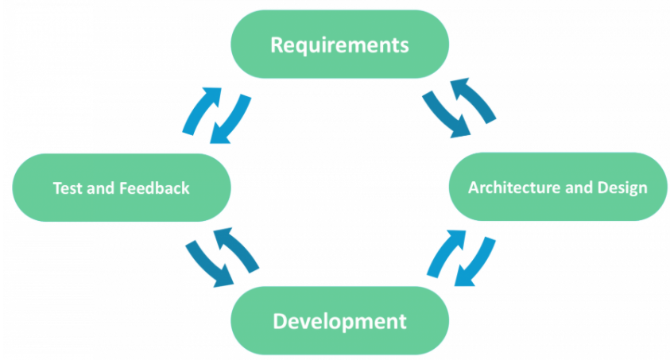

Slide 17
Reference
www.google.com
web.learncodeonline.in
www.W3school.com
django documentation

Slide 18
Thank You !!

